Slide 1
Figma Course
Outline
Instructor Name: Nshimiyimana Christophe
Location : On-Site, Makuza Peace Plaza
Duration: 8 weeks
Introduction to Figma
Website : www.tsindamedia.com
Tel : +250 798 873 226

Slide 2
Course Overview
Objective: Teach students how to use Figma to design interfaces, create prototypes, and collaborate efficiently.
Key Topics Covered:
1. Introduction to Figma
2. Figma's Interface and Tools
3. Creating Wireframes
4. Designing High-Fidelity Interfaces
5. Prototyping and Interactions
6. Collaboration and Teamwork in Figma

Slide 3
Why Learn Figma?
Importance:
Cloud-based tool for real-time collaboration.
Industry standard for UI/UX design.
Career Opportunities:
UI/UX Designer
Product Designer
Frontend Developer
Design Lead

Slide 4
Module 1: Introduction
to Figma
What is Figma?
Definition: Figma is a cloud-based design tool used for creating user interfaces, wireframes, and prototypes. It allows multiple users to work simultaneously on the same design project.
Key Features:
Real-time collaboration
Vector-based design
Interactive prototypes
Cross-platform access (browser and desktop apps)
Figma vs. Other Tools:
Figma vs. Adobe XD: Browser-based collaboration vs. desktop-first design.
Figma vs. Sketch: Cross-platform vs. Mac-only.

Slide 5
Understanding Figma's
Interface
Overview of the Workspace:
Toolbar: Essential tools for creating and manipulating design elements.
Layers Panel: Organize and manage design components.
Properties Panel: Adjust settings like color, typography, and effects.
Canvas: The main area where design work is done.
Project Structure:
Files and Pages: Organize different parts of the design process.
Frames and Artboards: Define the boundaries of individual screens or components.

Slide 6
Hands-On Practice: Exploring Figma's Interface
Task: Create a new Figma file, explore the workspace, and become familiar with the toolbar, layers, and properties panels.

Slide 7
Module 2: Creating Wireframes
in Figma
Introduction to Wireframing
What are Wireframes?: Simplified, low-fidelity representations of a design's structure.
Importance of Wireframes:
Define the layout and hierarchy of content.
Facilitate early-stage feedback without focusing on visual details.
Types of Wireframes:
Low-fidelity: Basic shapes and placeholders.
High-fidelity: Detailed elements with closer alignment to the final design.

Slide 8
Tools and Techniques for Wireframing
Using Figma's Shape Tools:
Creating rectangles, lines, circles, and other basic shapes.
Grid Systems:
Setting up a grid to ensure consistency in spacing and alignment.
Using Frames and Auto Layout:
Organize elements within frames for responsive design.
Auto Layout for dynamic resizing of UI components.

Slide 9
Hands-On Practice:
Creating a Wireframe
Task: Design a low-fidelity wireframe for a simple mobile app interface using shapes, frames, and grids.

Slide 10
y.
Module 3: Designing High-Fidelity Interfaces
Transitioning from Wireframes to High-Fidelity Designs
Definition of High-Fidelity Design: Detailed, visually polished representations of the final product.
Steps to Transition:
Replace placeholders with real content.
Apply color schemes, typography, and imagery.
Use design systems or style guides for consistency.

Slide 11
Figma's Design Tools
Working with Color:
Creating and applying color styles.
Using gradients and shadows for depth.
Typography in Figma:
Text styles for consistency across the design.
Pairing fonts and adjusting text settings.
Using Components:
Creating reusable UI elements (buttons, headers, etc.).
Leveraging variants for component states (hover, active, disabled).
Images and Icons:
Importing and editing images.
Using icon libraries or creating custom icons.

Slide 12
Hands-On Practice: Designing
a High-Fidelity Interface
Task: Take a wireframe and enhance it with colors, typography, images, and components to create a high-fidelity design.

Slide 13
Module 4: Prototyping and Interactions
OUTPUT DEVICES
Introduction to Prototyping
What is Prototyping?: Creating an interactive version of your design to simulate user experience.
Importance:
Test and validate design ideas before development.
Communicate functionality to stakeholders and developers.
Types of Prototypes:
Click-through: Simple navigation between screens.
Interactive: Includes animations and micro-interactions.
It is any piece of computer hardware that receives data from one source and converts it into another form.
It is also a computer equipment that convert information into a human-perceptible form.

Slide 14
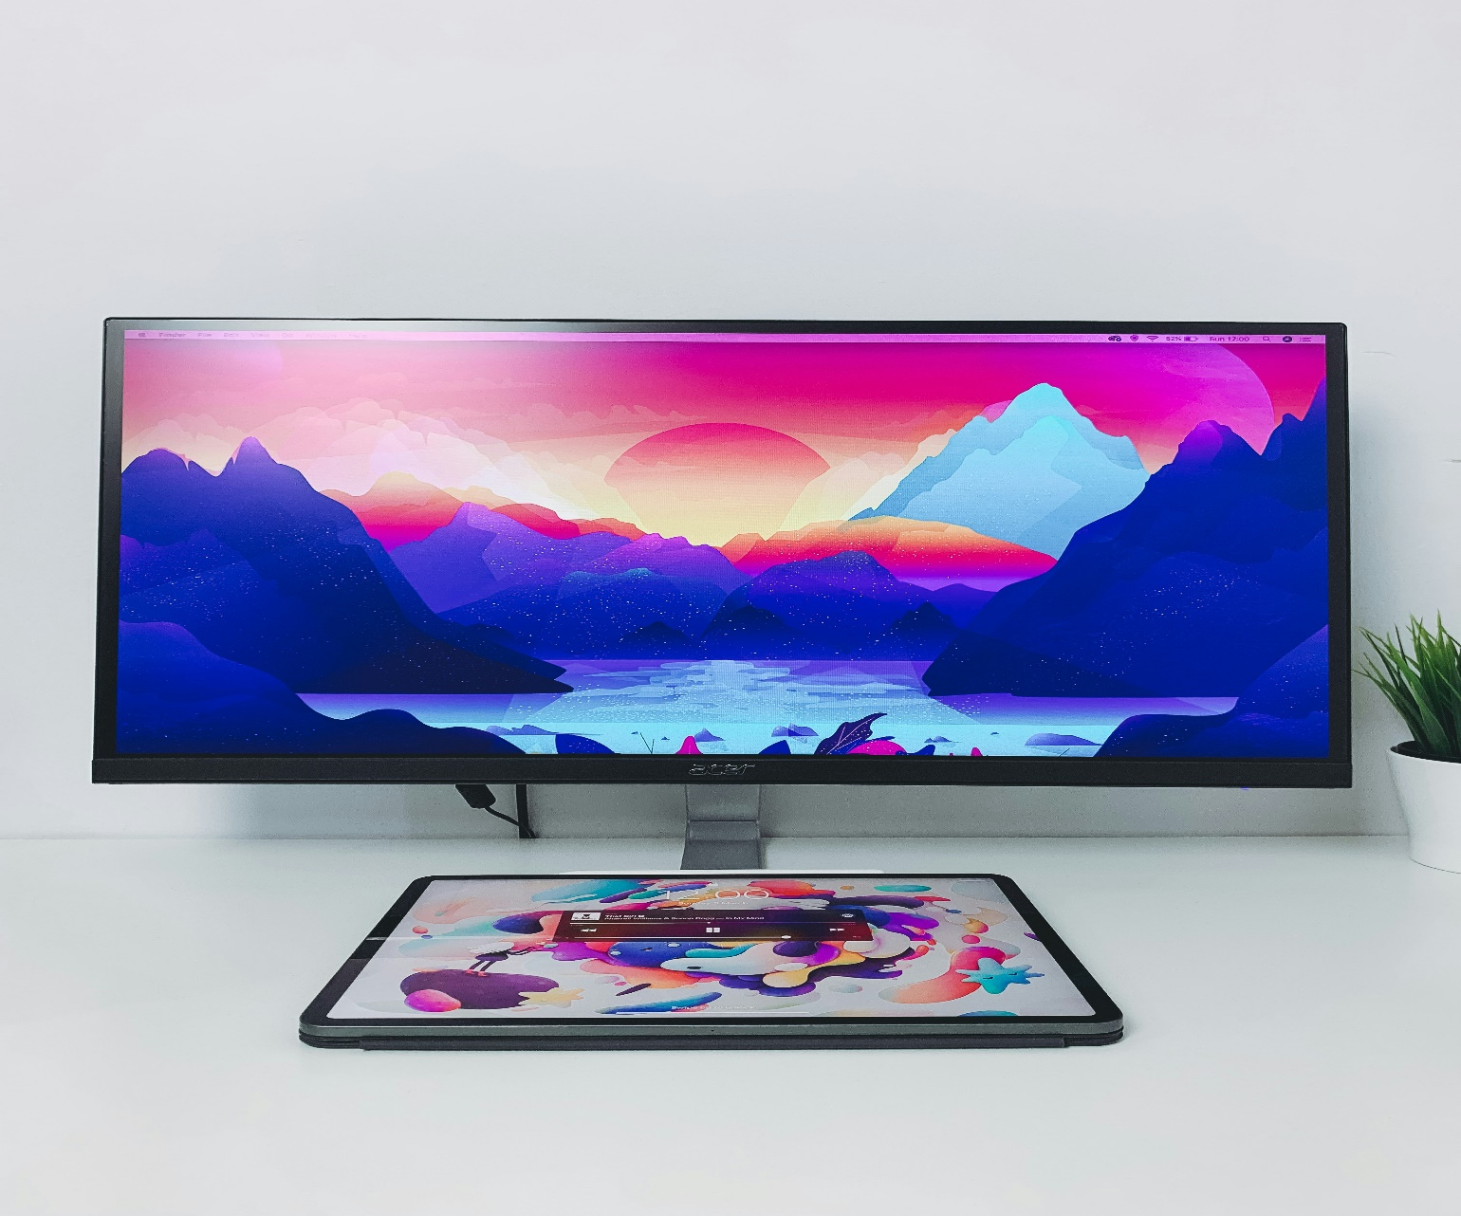
Creating Prototypes
in Figma
Monitor
OUTPUT DEVICES
Monitor, or display, is an output device that shows visual information generated by a computer.
Setting Up Navigation:
Linking frames with interactions (on click, hover, etc.).
Creating navigation flows (e.g., from home screen to details screen).
Adding Interactions:
Transition effects (slide, dissolve, etc.).
Using smart animate for smooth transitions between similar frames.
Testing and Sharing Prototypes:
Previewing the prototype in Figma.
Sharing with others for feedback using Figma’s sharing features.
It is any piece of computer hardware that receives data from one source and converts it into another form.
It is also a computer equipment that convert information into a human-perceptible form.
It provides a visual interface for users to view applications, documents, videos, and more.

Slide 15
Hands-On Practice: Creating a Prototype
Task: Create a simple interactive prototype for a mobile app, including navigation and basic interactions.

Slide 16
Module 5: Collaboration
and Teamwork in Figma
Real-Time Collaboration in Figma
Collaborative Features:
Multiple users can edit the same file simultaneously.
Commenting system for feedback and discussions.
Version history to track changes.
Roles and Permissions:
Understanding Figma teams, projects, and file permissions.
Assigning roles (viewer, editor, owner).

Slide 17
Working with Figma Plugins and Integrations
Popular Plugins:
Content Reel: Manage placeholder content.
Unsplash: Quick access to stock photos.
Figmotion: Add animations to your designs.
Integrating with Other Tools:
Exporting designs to development tools (e.g., Zeplin, Avocode).
Connecting Figma with Slack, Trello, or other project management tools.

Slide 18
Hands-On Practice: Collaborating
in Figma
Task: Collaborate with a peer to refine a design, provide feedback through comments, and utilize a plugin to enhance the design process.

Slide 19
Final Project
Project Overview:
Objective: Create a fully functional design and prototype for a digital product (e.g., a mobile app or website) that demonstrates your mastery of Figma.
Components:
1.Create wireframes for the product.
2. Develop high-fidelity designs using proper color schemes, typography, and components.
3. Create an interactive prototype with navigation and interactions.
4. Collaborate with a peer to refine and finalize the design.

Slide 20
Thank you for your participation! With Figma, you're now equipped to design and collaborate like a pro. Keep pushing your creativity to new heights!
Website : www.tsindamedia.com
Tel : +250 798 873 226

